Slide 1

Department of Information Technology A.P. Shah Institute of Technology G.B.Road,Kasarvadavli, Thane(W), Mumbai-400615 UNIVERSITY OF MUMBAI Academic Year 2019-2020
Notes:
1

Slide 2
A Presentation on IOT based Accident Alert System Submitted in partial fulfillment of the degree of Bachelor of Engineering(Sem-8) in INFORMATION TECHNOLOGY By Kunal Kale (16104027) Chinmay Kubal (16104023) Viranchee Patil (16104044) Under the Guidance of Prof. Kaushiki Upadhyaya
Notes:
2

Slide 3
1.Project Conception and Initiation
Notes:
3

Slide 4
1.1 Abstract
The Indian Ministry of Road Transport and Highways reports that around 4,06,730 accidents take place each year and close to 86,000 are killed! In frequently crowded areas like cities or highways, more than 65% lives are lost due to delay in the arrival of emergency services. If we consider accidents taking place in secluded areas,then the percentage of lives lost is even more. With an aim to reduce these numbers to as little as possible, we propose a system which makes use of IoT sensors along with Cloud Computing.
Notes:
4

Slide 5
1.2 Objectives
To develop a cheap, state-of-art accident detection system for vehicles.
To provide smart assistance to the car crash victim.
To contact the concerned emergency authorities on the victim's behalf.
Notes:
5

Slide 6
1.3 Literature Review : Paper 1
Title: Real-Time Crash Detection Analysis and Emergency Alert Using Smartphone
Authors: Harit Sharma, Ravi Kanth Reddy, Archana Karthik
Publication Details : International Conference on Connected Vehicles (ICCVE), 2016
Findings: Detecting car crashes using sensors present inside mobile phones.
Advantages: Makes use of in-built sensors, so does not require any addidtional components/modules.
Disadvantages: Makes use of a mobile device for car crash detection.
Notes:
6

Slide 7
Paper 2
Title: Intelligent Accident Management System Using IoT and Cloud.
Authors:Akriti Singhal, Sarishma, Ravi Tomar
Publication Details : 2nd Intl. Conference on Next Generation Computing Technologies (NGCT), 2016
Findings: Detecting car crashes using IoT sensors and uploading the data on Cloud using GSM module.
Advantages: Data is uploaded to cloud.
Disadvantages: Low processing speed and internet speed due to microcontroller and GSM module respectively.
Notes:
7

Slide 8
Paper 3
Title: A Smart Accident Detection and Control System in Vehicular Networks
Authors: Md. Saeef Abdul Hadi, Abhijit Saha, Faysal Ahmad, Mohammad Shahriyar Hasan, Mehebub Hasan Milon
Publication Details : 5th International Conference on Networking, Systems and Security (NsysS), 2018
Findings: Developed an accident management system for accidents taking place at a junction.
Advantages: Driver's are alerted about the exact lane number in which the accident has taken place via a message.
Disadvantages: In case of heavy traffic, a slight delay in broadcasting the message can lead to even more people getting involved in car crash.
Notes:
8

Slide 9
Paper 4
Title: A Comprehensive Solution to Road Traffic Detection and Ambulance Management
Authors: Hari Sankar S, Jayadev K, Suraj B, Aparna P
Publication Details : International Conference on Advances in Electrical, Electronic and System Engineering, 14-16 Nov 2016
Findings: Developed a system to address the problem of delay minimization right from when an accident occurs till the time when the patient is handed to the casualty.
Advantages: Using Google Maps API only the ambulances nearest to the accident spot are informed.
Disadvantages: None.
Notes:
9

Slide 10
1.4 Problem Definition
To create an assistive system for car crash victims which will automatically alert nearby authorities that can arrive on the scene in quick succession of time, thereby possibly saving the victim's life.
Based on the impact of collision, the system will automatically send a notification to the service stations, local clinics, police stations, hospitals, etc.
Notes:
10

Slide 11
1.5 Scope
With the ever increasing number of vehicles, the number of accidents taking place is also increasing exponentially. In order to aid the car crash victims, we propose a system that makes use of various IoT sensors that are capable of determining the collision impact and sending automatic alerts to the help providers.
Also, the implemented system will be a lot more cheaper than the automatic accident detection systems that are currently present only in high-end cars.
Notes:
11

Slide 12
1.6 Technology stack
Hardware :
NodeMCU : Acts as the main microcontroller to integrate functioning of other components
GSM Module : For automatic emrgency calling
GPS Module : For providing geographical location
Accelerometer : For measuring change in acceleration
Vibration Sensor : For detecting change in various physical parameters such as acceleration, temperatue, etc.
Notes:
12

Slide 13
1.6 Technology stack
Software :
DynamoDB : For database storage
AWS : For providing services related to the system like Simple Notification Server, etc.
Google location API : For providing latitudinal and longitudinal coordinates on the map and also for locating services nearby
Notes:
13

Slide 14
1.7 Benefits for environment & Society
Accident Alert Systems are not a recently discovered mechanism,they have been around for quite some time now and yet a lot of the people are unaware of it. This is because such an accident detection system is only present in Luxury tier cars like BMW, Maseratti to name a few. With our project, we aim to develop an affordable Accident Alert System that can be externally fitted into vehicles of all tiers. The system will ensure that emergency services are contacted automatically without wasting any precious time. Thereby hoping to reduce the number of car crash fatalities by a considerable amount.
Notes:
14

Slide 15
2. Project Design
Notes:
15

Slide 16
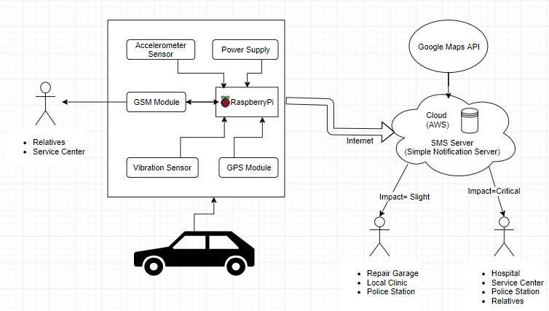
2.1 Proposed System with Flow of modules
Notes:
16

Slide 17
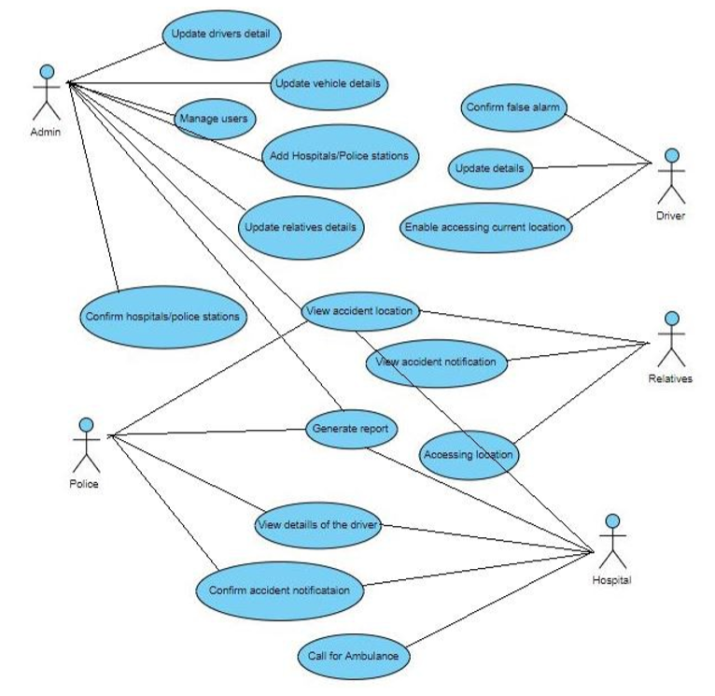
2.2 Use Case
Notes:
17

Slide 18
Description Of Use Case
Update driver details : For updating details of the driver like city,car,etc.
Update vehicle details : For updating the details of the vehicle.
Manage users : To add or delete a user.
Add Hospital/Police Station : To add a new Hospital/Police station into the database.
Update Relatives details : For updating details of the driver's relatives.
Confirm Hospital/Police Station : To confirm if the hospital/police station will send emergency services to the accident spot.
View Accident notification : For viewing the emergency alert sent by the Accident alert system.
Confirm Accident notification : For the Police to confirm if they have received an alert regarding the accident.
Notes:
18

Slide 19
.
Generate Report : To generate an entire report about the accident.
View details of the driver : For viewing the details of the driver.
View Accident Location : For viewing the exact location of the accident spot.
Confirm False alarm: Can be used only by the driver to confirm if the emergency alert is a false alarm.
Notes:
19

Slide 20
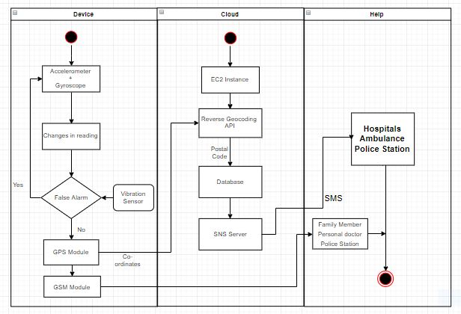
2.3 Activity diagram
Notes:
20

Slide 21
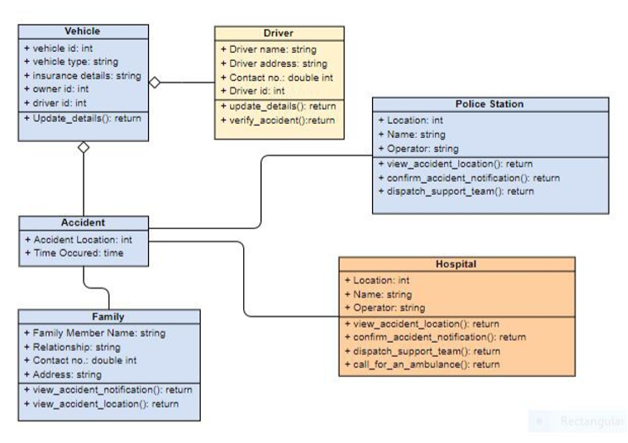
2.4 Class Diagram
Notes:
21

Slide 22
2.5 Modules : NodeMCU
Description : A small microcontroller that integrates various sensors together for a common purpose.
Integration in our project : It will act as the main microcontroller for integrating other sensors like accelerometer,vibration sensor,GSM and GPS modules. It also offers wifi connectivity which will be used for accessing the Cloud.
Notes:
22

Slide 23
Accelerometer
Description : A sensor used for measuring change in acceleration.
Integration in our project : It will be connected to the Raspberry Pi, so if any sudden change is detected it will broadcast the data to the other sensors in order to trigger the accident alert system.
Notes:
23

Slide 24
Vibration Sensor
Description : For detecting change in various physical parameters.
Integration in our project : The vibration sensor is capable of detecting changes in temperature, acceleration, etc. So it will be vital in case of determining if the crash is a false alarm or not.
Notes:
24

Slide 25
GPS Module
Description : A module used for detecting the geographical location of an object on the map
Integration in our project : With the help of a GPS module, the exact coordinates in terms of latitude and longitude will be obtained. After acquiring the coordinates, they will be sent to the Cloud.
Notes:
25

Slide 26
GSM Module
Description : A module used for establishing connection between a computing device and a GPS/GSM system
Integration in our project : In our project, the GSM module will be used a backup for Cloud Computing. In geographical locations where Cloud connectivity is not possible, the GSM module will be used to send alerts to the mobile numbers that are already stored.
Notes:
26

Slide 27
Cloud Computing
Description : The practice of using a network of remote servers hosted on the internet for computing
Integration in our project : For our project, we will be using the following Cloud services:
EC2 Instance : To host an environment that will be useful for integrating other Cloud services.
Reverse Geocoding : The coordinates received from the GPS module will be processed using this service to obtain the Name of the geographical location.
Database : Will be used for storing various tables that contain information about the driver's details as well as the emrgency service's details.
SNS Server : For hosting the simple notification service. This will be used to send alerts regarding the accident to the nearest emergency services automatically on the victim's behalf.
Notes:
27

Slide 28
3. Future Scope
Notes:
28

Slide 29
For our future work, we would like to make an application on all mobile phone platforms, wherein the user can gain access to all the services offered by our current system, but with a GUI. The application will also monitor the speed, routes, nearby destinations,etc and provide the driver with a complete driving experience.

Slide 30
2.6 References
Akriti Singhal, Sarishma, Ravi Tomar, “Intelligent Accident Management System using IoT and Cloud Computing” , 2nd International Conference on Next Generation Computing Technologies (NGCT-2016) Dehradun, India 14-16 October 2016
Harit Sharma, Ravi Kanth Reddy, Archana Karthik, “S-CarCrash: Real-time crash detection analysis and emergency alert using smartphone” , International Conference on Connected Vehicles and Expo (ICCVE), 2016
Md. Saeef Abdul Hadi, Abhijit Saha, Faysal Ahmad, Mohammad Shahriyar Hasan, Mehebub Hasan Milon, “A Smart Accident Detection and Control System in Vehicular Networks” , 5th International Conference on Networking, Systems and Security (NsysS), 2018
Hari Sankar S, Jayadev K, Suraj B, Aparna P, “A Comprehensive Solution to Road Traffic Detection and Ambulance Management” , International Conference on Advances in Electrical, Electronic and System Engineering, 14-16 Nov 2016
Notes:
30

Slide 31
Thank You!!
Notes:
31

